Slide 1

Afghanistan
Women's Rights and Education
By: Laila and Josie

Slide 2
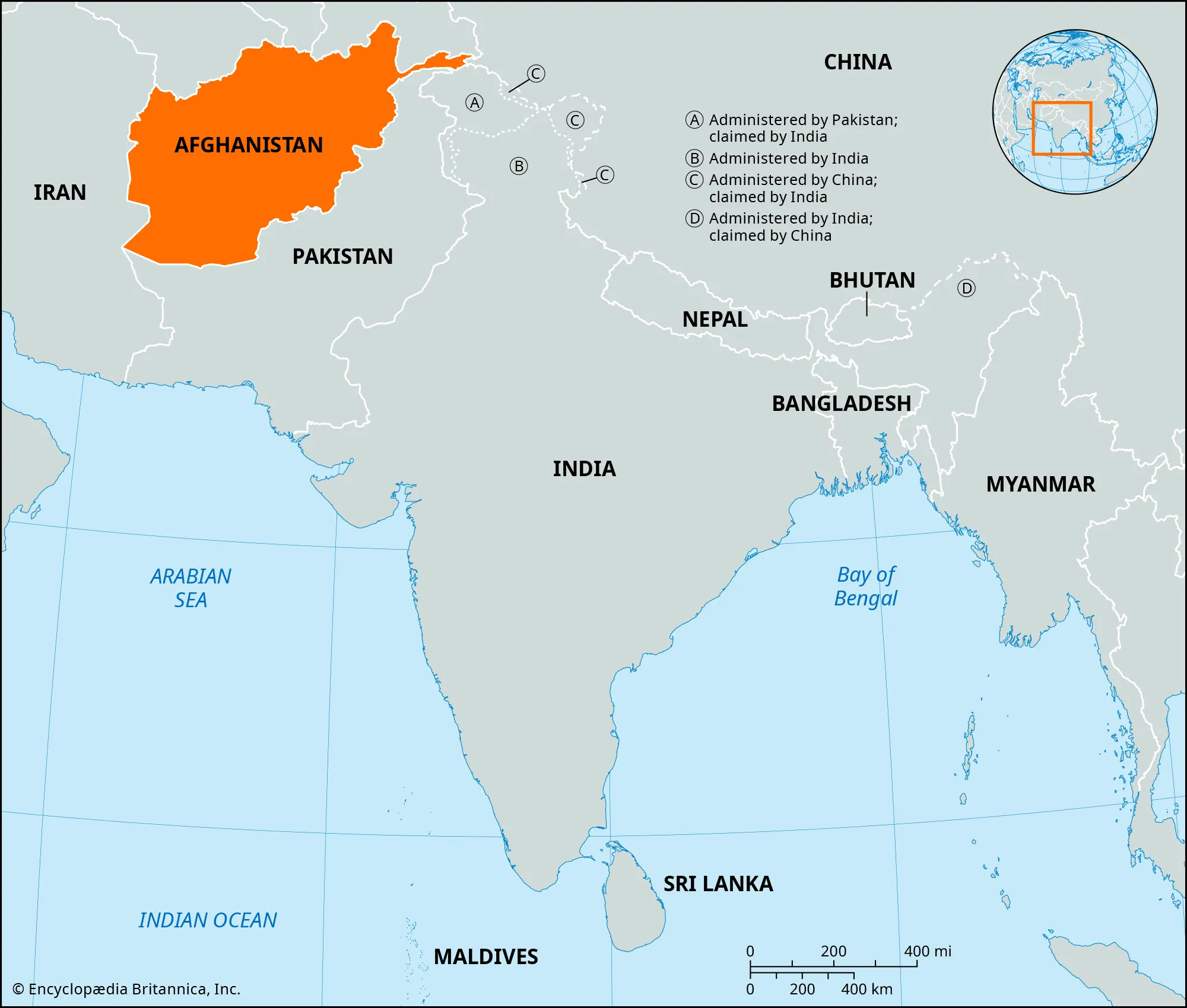
Afghanistan’s background
Culture/language: Afghanistan is a multilingual society with over 40 languages and lots of dialects spoken across different regions. The most common languages include Dari (Afghan Persian), and Pashto. Afghanistan has a traditional, fundamentalist culture rooted in Islamic principles.
Economic Context: Afghanistan has one of the poorest economies in the world even though it has such valuable natural resources. Some of the resources they have are minerals and there are lots. Some are lithium, copper, iron, gold, cobalt and so much more. They also are known for their farming and growing fruits and nuts. There is pomegranates, grapes, melons and other dry fruits. But however, after years of wars and political problems it has been hard to get these resources. Because of this afghanistan is one of the poorest countries in the world and imports more than exports.

Slide 3
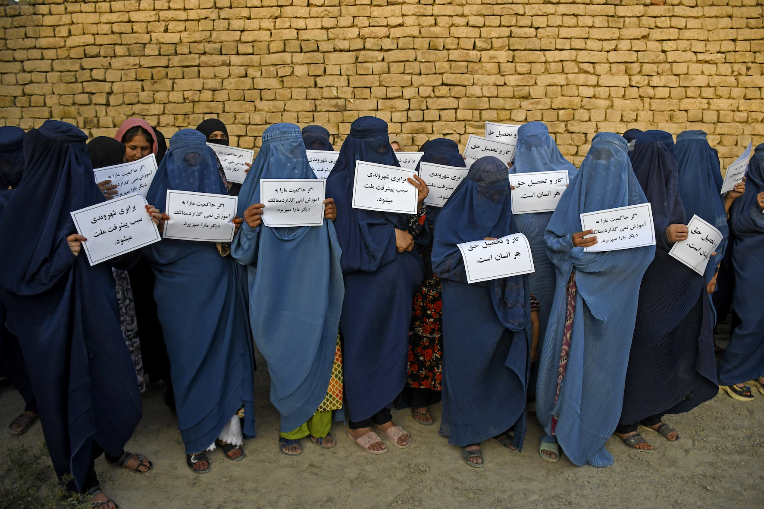
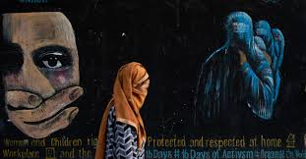
The main issue
The main facing issue in afghanistan for girls is the limited access to education Women's rights and education are major issues in Afghanistan. Women's rights means that girls and women should get equal access to all opportunities for education, healthcare, jobs and other basic opportunities. Since 2021 when the power of the taliban was returned, afghanistan became the one country that bans girls and women from secondary school and anything higher. at least 1.4 million girls have been denied access to attend secondary education, and in total, 3.8 million girls in Afghanistan are out of school, all of their knowledge and talents are getting lost or wasted. Woman are also facing lots of challenges when trying to access healthcare, getting jobs and other opportunities.Since the takeover, fear, travel restrictions, ban from education, and systemic discrimination are keeping the woman from things they need, and woman have been scared to even leave their homes. Here's a fact: 1 in 3 girls were being forced into marrage before the age of 18. This number continues growing and has an impact on women

Slide 4
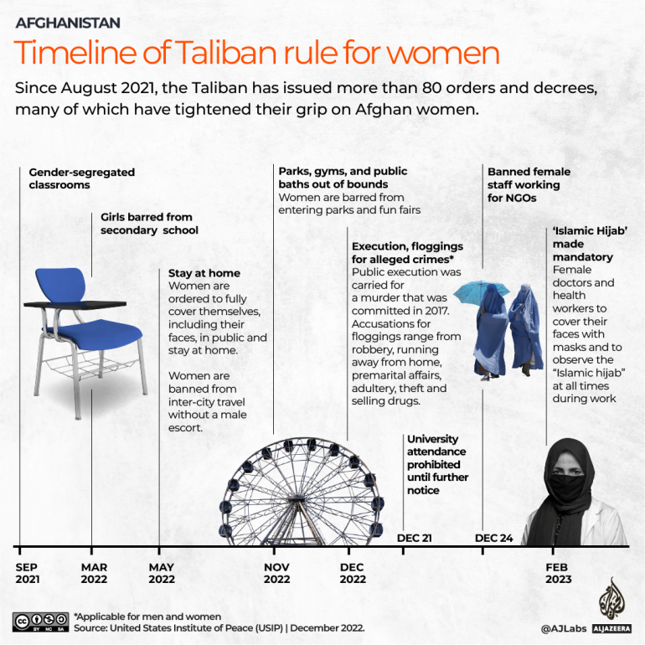
Country's response
In Afghanistan, the taliban governent since 2021 has just responded to womens rights and their education by continuing to introduce and enforce more strict rules, some that include baning girl above grade 6 from attending school. This just shows how this is active government actions that continue rather than trying to improve things for girls and women or getting them access into education. Evidence we can see from UNESCO, they reported that 80% of Afghanistan girls and young women are not attending school or university which has affected 2.5 million girls. And even the United Nations describes Afghanistan as “most repressive country in the world” for womens rights and their education. UNESCO has been trying and making a effort to provide and make alternative methods for their learning even with all of the difficult policies and conditions.

Slide 5
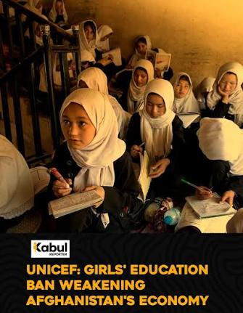
Consequences
There were lots of consequences resulting from the women's right and education issue. There were lots of long term and short term issues coming from this. The most common short term issues were psychological shock and despair among the girls and women. Girls from sixth grade and above remained psychologically shocked and very disappointed on the first day of the academic year late March 2022 when they were prevented from attending school. The long-term lack of female students and teachers is expected of a severe shortage or lack of specialists in the next decade or two, especially in the health and education areas. The taliban intended for keeping all women out of schools, universities, and regular workplaces. As well as they wanted to force the women to stay home unless they had a male relative accompanying them. They didn’t intend for more mothers dying because of the lack of female doctors, the taliban wanted to control the borders, they didn't want or intend Violent groups like ISIS to grow stronger and start fights with neighbor countries.

Slide 6
Canada and reflection
Canada has been a great support to the people from afghanistan that immigrate here. They have welcomed into Canada over 40 000 of the vulnerable people which came from Afganistan. They used special measures and programs to help get them here. When people come from there, they are really traumatized and phsycoligcally shocked, and Canada helps out by supporting them with specialized resettlemt programs, income assistance, and to help with their trauma, they are connected with physiological support programs, community peer and support programs, and any healthcare they may need. Canadians should care about this because the issue affects global peace, human rights, and Canadas own history! When Afghanistan doesnt have a stable governemnt, terrorist groups can grow and threaten safety all over the world, including Canada. Another reason is because when all these things are going on in afghanistan, people are going to immigrate and leave there, so Canada has to support those people and Canadians are inclduded in the support. Also this ties to Canadas history because over 40 000 canadian soldiers served there to protect their country and support womens rights. In that time, 158 Canadian soldiers died and women in Afganistan getting ignored is wasting our Candains soldiers sacrifices and apart of Canadas history.

Slide 7
Sources we used!
Medica Mondiale. (no date). Women’s rights in Afghanistan. https://medicamondiale.org/en/where-we-empower-women/afghanistan
Al jazeera news. (2023). International Women’s Day: The exclusion of Afghanistan’s women. https://www.aljazeera.com/news/2023/3/8/international-womens-day-the-exclusion-of-afghanistans-women
UN Women. (2025). FAQs:What it’s like to be a woman in Afghanistan today. https://www.unwomen.org/en/articles/faqs/faqs-afghanistan
UNESCO. (2024). Afghanistan: 1.4 million girls still banned from school by de facto authorities. https://www.unesco.org/en/articles/afghanistan-14-million-girls-still-banned-school-de-facto-authorities
Zan times. (2024). Consequences of Taliban’s ban on women’s education. https://zantimes.com/2024/03/21/consequences-of-talibans-ban-on-womens-education/

